Slide 1
ADVANCED DATA SCIENCE CAPSTONE PROJECT
-by Kalpit Gupta

Slide 2
PREDICTING COVID-19 RECOVERY CASES
In this project I will be using a dataframe which has been updated since 22nd January till 25th May of 2020. Every entry is basically an update about a particular province/place of the total number of confirmed cases, total deceased and the recovered cases. Using the data given I will try to check whether my model can predict the amount of patients recovered in the data frame.

Slide 3
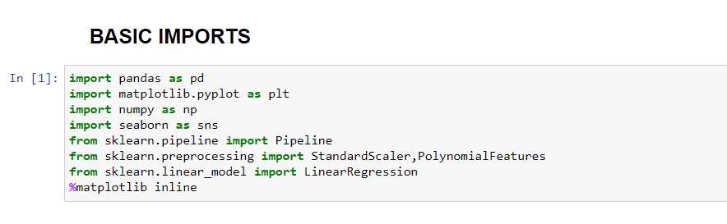
IMPORTS
Several mainstream libraries like pandas, sklearn, matplotlib were used for this package for data processing, data visualization, model fitting etc.

Slide 4
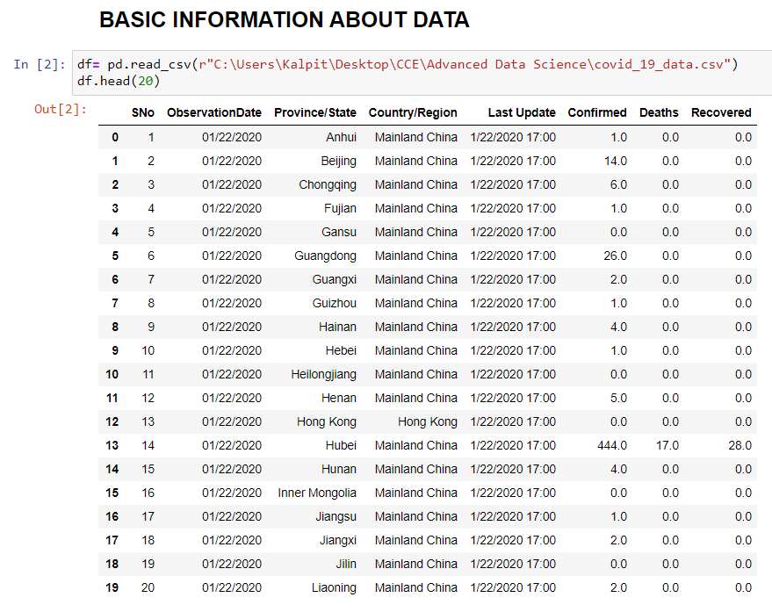
The only information that is necessary to us is Observation date, Place, Confirmed cases, Deaths and recovered cases.
Other columns liks Sno and Last Update are of no use while Province is at a whole microscopic level, we will merge country entries and get rid of provinces as well.

Slide 5
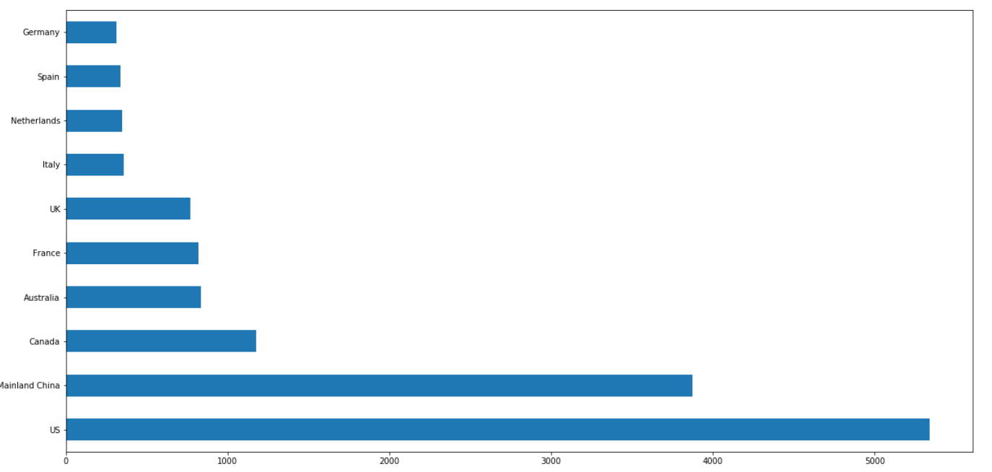
BASIC EDA
The above graph shows the top 10 countries with the most entries in the dataframe. USA has updated the dataframe the maximum times followed by China.

Slide 6
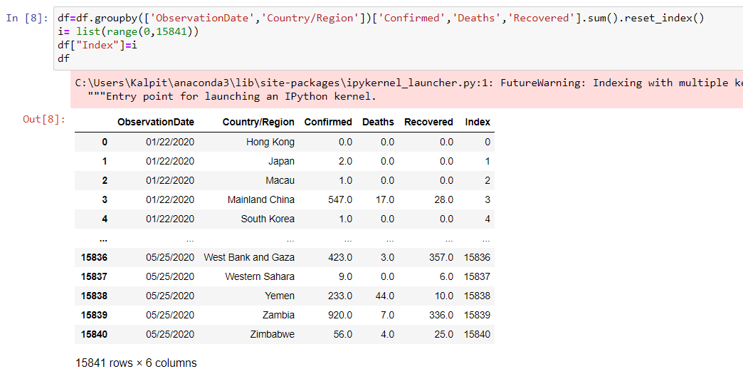
By getting approaching the situation on a global level, instead of provincial level, I have merged the cases of countries at the same timestamp. The total entries have dropped down from 29000 to 15000, which is nearly 2 times in magnitude.

Slide 7
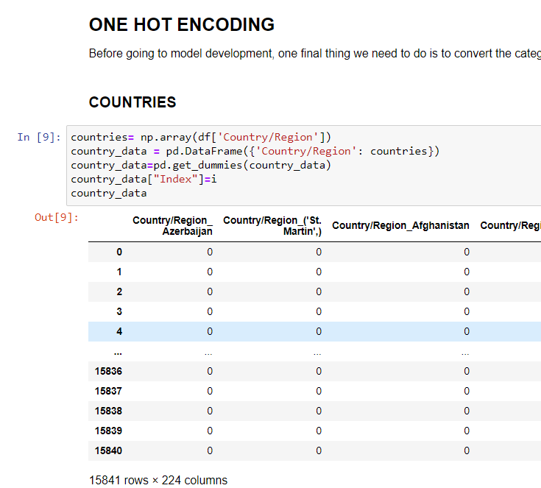
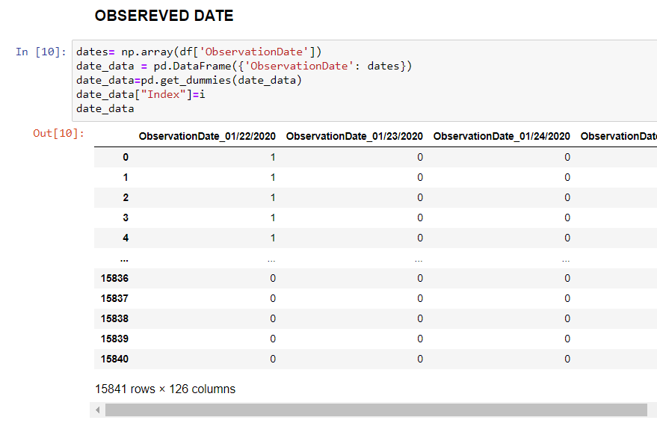
USING ONE-HOT ENCODING
For Linear Regression, the model does not accept string as one of its inputs so in order to use countries and observation data, we use one hot encoding and later merge them into the main datarame. This is far beyond our understanding, but python understands it very well.

Slide 8
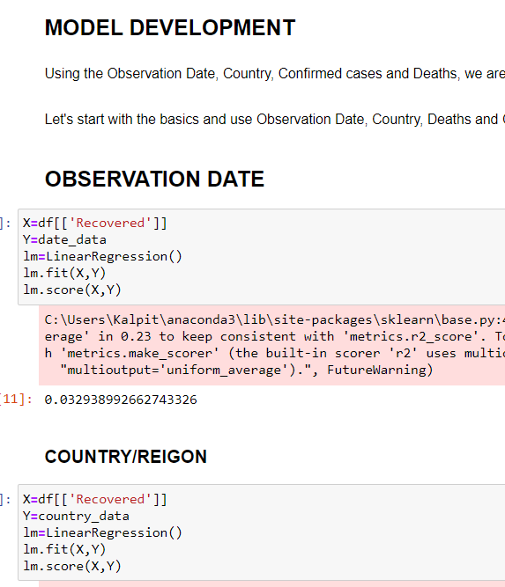
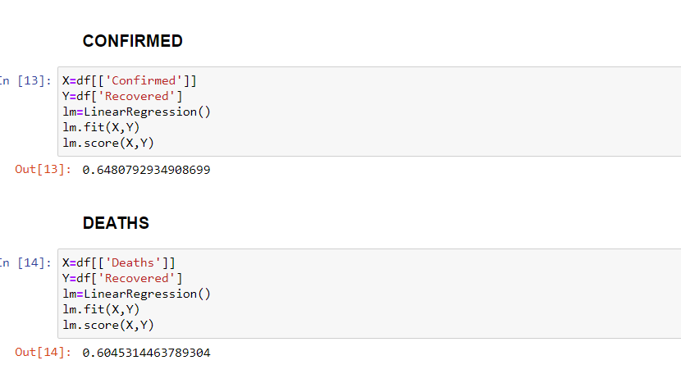
MODEL DEVELOPMENT
Using linear regression, we first separately fit the label with each feature turn by turn just for the sake of formality. And the score isn’t so good, but we will probably have a good luck with all the features being used together.

Slide 9
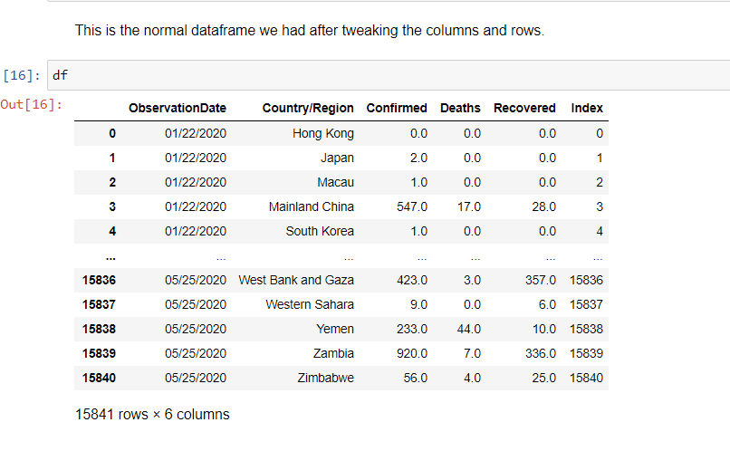
This is the original dataframe we had after we changed a couple of things and eventually cleaned it.

Slide 10
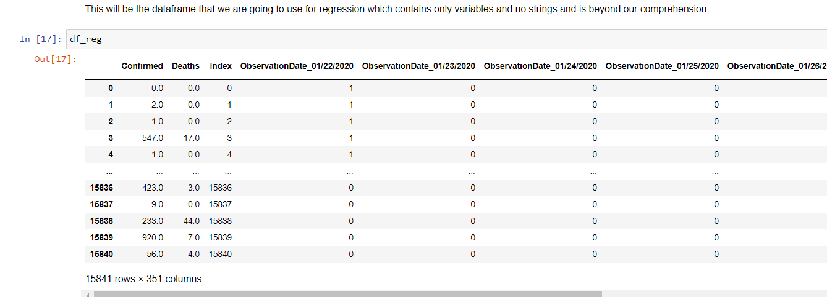
This is the dataframe that we’re going to use for the model since the we cannot fit linear regression model with strings (country names and dates) and we needed to use one hot encoding.

Slide 11
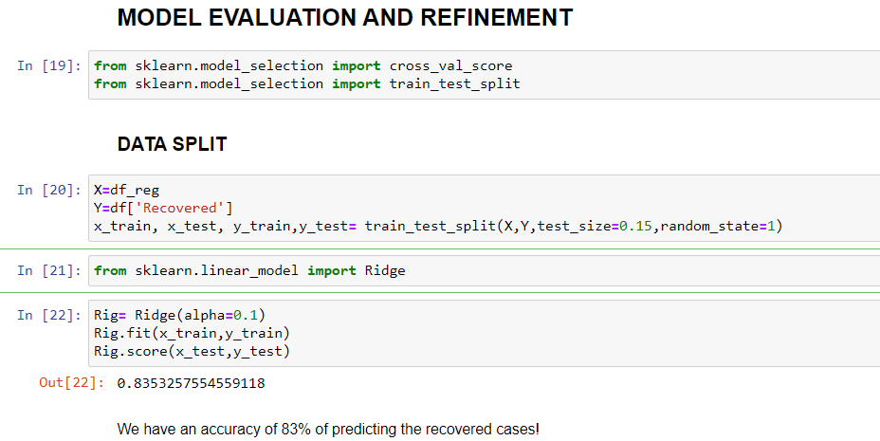
MODEL EVALUATION AND REFINEMENT
Finally I split the data in test=(15%) and train=(85%) sets respectively. By fitting our data in the train set I try to predict the data by using the test set and I come to the conclusion that my model has a whopping accuracy of 85%

Slide 12
REFERENCES
While my Watson studio project has the .csv of the covid-19 entries, I got the dataframe from the link below.
https://www.kaggle.com/sudalairajkumar/novel-corona-virus-2019-dataset?select=covid_19_data.csv

Slide 13
THANK YOU FOR YOUR TIME!

